Slide 1
Graph Clustering Based on Structural/Attribute Similarities
Graph Clustering Based on Structural & Attribute Similarities
Sumanth CS15BTECH11013
Amarnath CS15BTECH11040

Slide 2
Abstract
Most of the graph clustering algorithms that are in existence focus mainly on topological structure for clustering, but largely ignore the vertex properties.
A new graph clustering algorithm SA-Cluster is proposed which focuses both on topological structure and vertex properties.
This new algorithm does this by a new distance measure and it partitions the graph into k clusters each having homogeneous attributes.

Slide 3
Introduction
Clustering is a unsupervised learning technique that groups similar objects into one cluster.
Clustering has its applications in analysis of biological data, time series data, spatial data, etc..
Graph is a data structure that is popularly used to model structural relationship between objects and has applications in social networks, sensor networks, etc..
Clustering on a large graph is to partition the graph into several densely connected components.

Slide 4
Motivation
Many existing graph clustering methods either focus on topological structure or attribute similarity.
In many real applications, both the graph topological structure and the vertex properties are important.
For example, in a social network, vertex properties describe roles of a person while the topological structure represents relationships among a group of people. Most of the graph clustering and summarization methods consider only one aspect of the graph properties but ignore the other.
So, ideal graph clustering should generate clusters which have a cohesive intra-cluster structure with homogeneous vertex properties, by balancing the structural and attribute similarities.

Slide 5
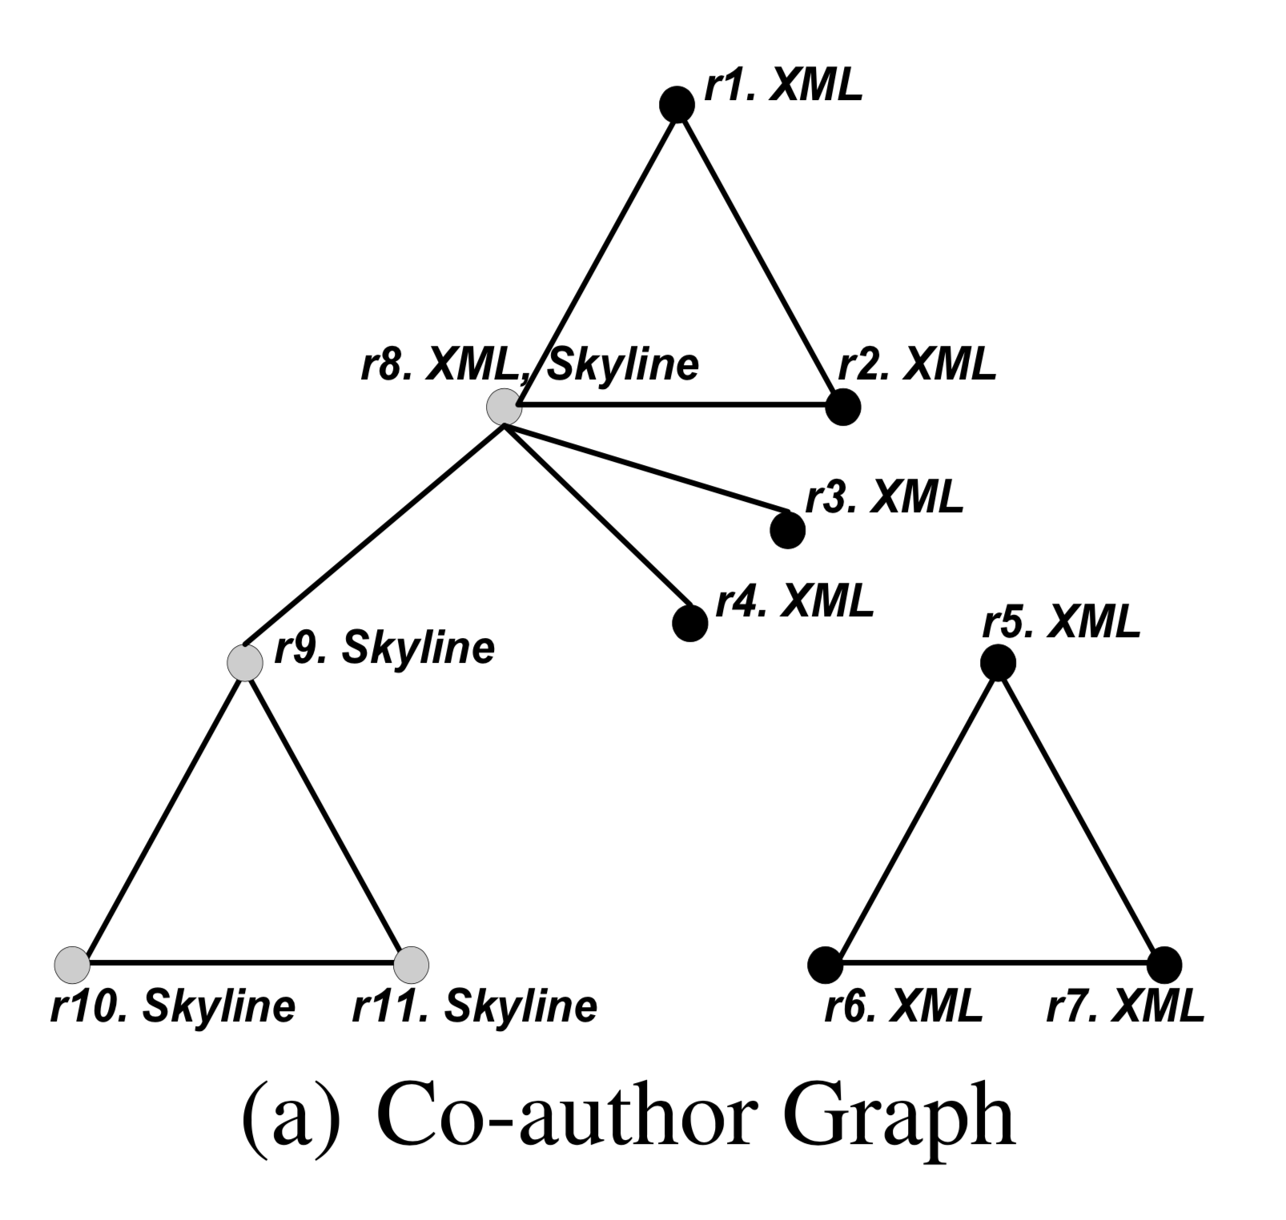
Example
Figure (a) shows an example of a co-author graph where:
vertex represents an author
edge represents the Co-author relationship between two authors.
ri represents author ID
XML, Skyline are research topics
The research topic is considered as an attribute to describe the vertex property.
As we can see, authors r1–r7 work on XML, authors r9–r11 work on Skyline and r8 works on both.
Given a cluster number k = 2, we could partition the graph into 2 clusters in several possible ways depending on the clustering criteria:
Structure-based Clustering
Attribute-based Clustering
Structural/Attribute Clustering

Slide 6
Structure-based Clustering
Figure (b) shows a clustering result based only on vertex connectivity, i.e., co-author relationship.
Authors within clusters are closely connected; however, they could have quite different topics, e.g., half work on XML and the other half work on Skyline in one of the clusters.
NOT IDEAL

Slide 7
Attribute-based Clustering
Figure (c) shows another clustering result based on attribute similarity, i.e., research topics.
Authors within clusters work on the same topics; however, the co-author relationship may be lost due to the partitioning so that authors are quite isolated in one of the clusters.
NOT IDEAL

Slide 8
Structural/Attribute Clustering
Figure (d) shows the clustering result based on both structure and attribute information.
This clustering result balances the structural and attribute similarities: authors within one cluster are closely connected; meanwhile, they are homogeneous on research topics.
This is the result we want to achieve in this work.
IDEAL

Slide 9
Summary
Structure-based Clustering
Vertices with heterogeneous values in a cluster
Attribute-based Clustering
Lose much structure information
Structural/Attribute Cluster
Vertices with homogeneous values in a cluster
Keep most structure information

Slide 10
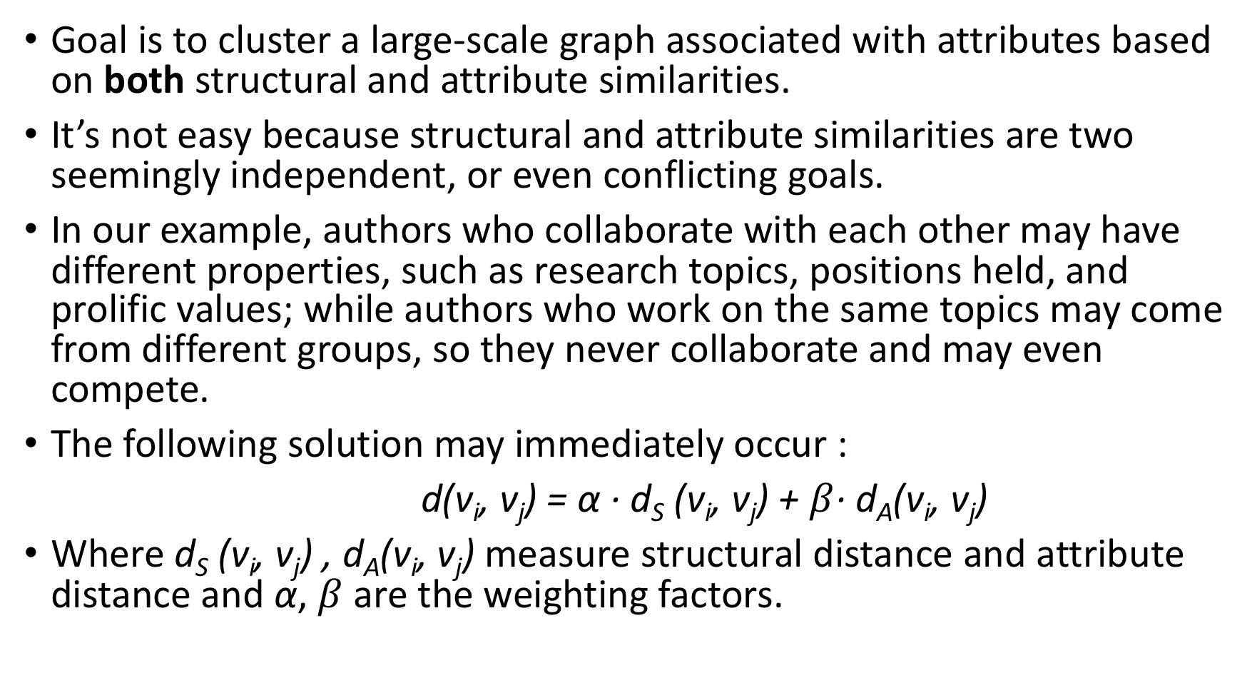
Goal is to cluster a large-scale graph associated with attributes based on both structural and attribute similarities.
It’s not easy because structural and attribute similarities are two seemingly independent, or even conflicting goals.
In our example, authors who collaborate with each other may have different properties, such as research topics, positions held, and prolific values; while authors who work on the same topics may come from different groups, so they never collaborate and may even compete.
The following solution may immediately occur :
d(v_{i}, v_{j}) = α · d_{S} (v_{i}, v_{j}) + $β$· d_{A}(v_{i}, v_{j})
Where d_{S} (v_{i}, v_{j}) , d_{A}(v_{i}, v_{j}) measure structural distance and attribute distance and α, $β$ are the weighting factors.

Slide 11
Although that method may be simple, it is hard to set/tune the parameters as well as interpret the weighted distance function.
For our example in Figure (a), it is not clear to a user whether the weight of co-author relationship should be larger or smaller than the weight of research topic similarity. It is even harder for the user to decide the weights quantitatively.
So, we integrate the structural and attribute similarities into a single graph by adding extra vertices called attribute vertices.
Now expressing attribute similarity is simple : two vertices which share an attribute value are connected by a common attribute vertex.
The new distance measure as described earlier is as follows:
Two structure vertices v_{i} and v_{j} are close either if they are connected through many other structure vertices, or if they share many common attribute vertices as neighbours, or both.

Slide 12
Adjust the degree of contributions of structural and attribute similarities
A structure edge and an attribute edge may have different importance in random walk paths. Different attributes may also have different contributions in random walk distance due to their different clustering tendencies. To model the degree of contributions of attributes, we assign a weight to each attribute. Then we need a mechanism to differentiate the weights of different attribute edges and need a learning algorithm to automatically adjust the weights as we partition the graph.
Guarantee clustering convergence
We will design a clustering objective function and aim to improve it towards convergence. But as the attribute edge weights are adjusted, the random walk distances are affected. So if we interleave the graph clustering process and attribute edge weight adjustment for progressive refinement of the cluster quality, will the clustering process converge?(YES)

Slide 13
Addressing to the challenges
A uniﬁed distance measure to combine structural and attribute similarities is proposed. Extra vertices, edges are added. A neighborhood random walk model is used to measure the vertex closeness.
Theoretical analysis is provided to quantify the contribution of attribute similarity to the uniﬁed random walk distances for measuring vertex closeness.
A weight self-adjustment method to learn the degree of contributions of diﬀerent attributes in random walk distances is proposed. It is proved that the edge weights are adjusted towards the direction of clustering convergence.
Finally, it is tested on real world large graphs and is found to be able to partition the graph correctly.

Slide 14
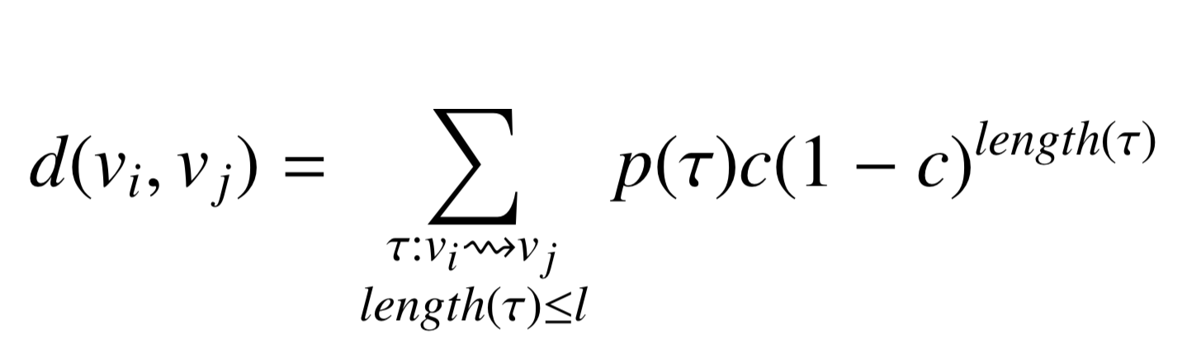
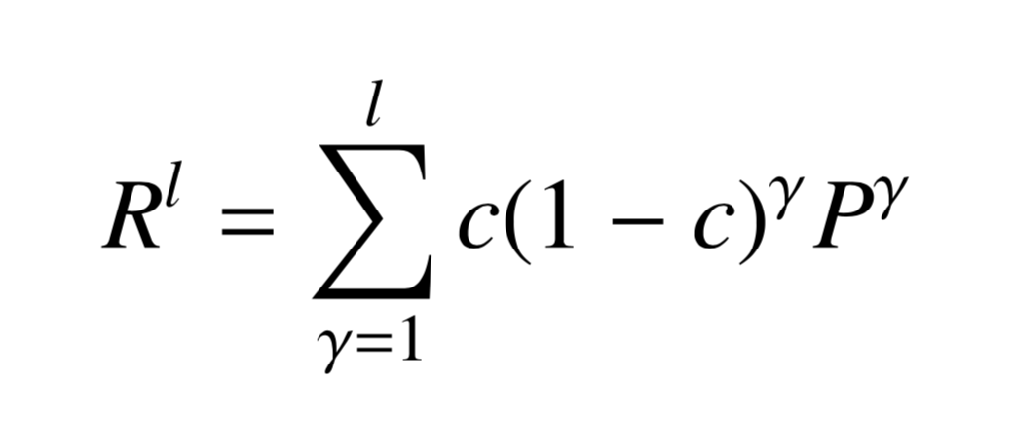
Structural Closeness Measure
Neighbourhood Random Walk Distance
Random walk distance d(v_{i}, v_{j}) from v_{i} to v_{j} is defined as :
The matrix form of the neighbourhood random walk distance is:
Then the structural closeness between two vertices v_{i} and v_{j} is :
d_{S} (v_{i}, v_{j}) = R^{l}(i,j)

Slide 15
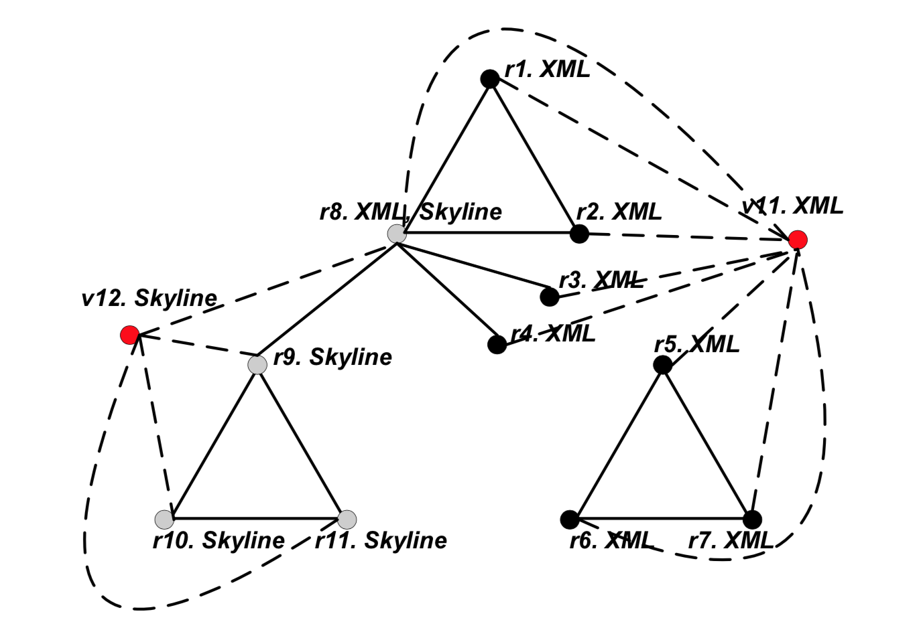
Unified Distance Measure
Attribute augmented graph
Created by adding the attribute vertices and are connected through attribute edges to the structural graph.
The Kinds of Vertices and Edges
Two kinds of vertices
The Structure Vertex Set V
The Attribute Vertex Set V_{a}
Two kinds of edges
The structure edges E
The attribute edges E_{a}
The attribute augmented graph :
G = ( V ∪ V_{a} , E ∪ E_{a} )

Slide 16
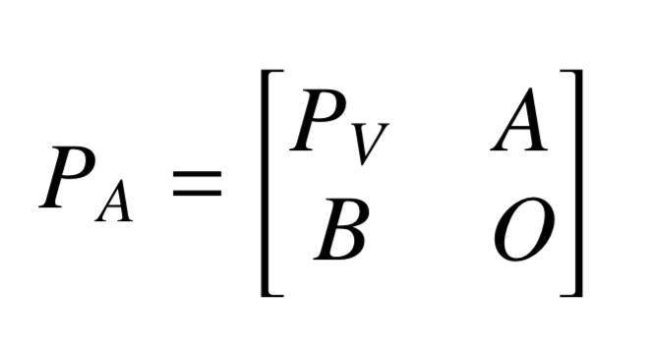
Transition Probability Matrix on Attribute Augmented Graph
Order of the matrices:
P_{V} is of order N*N
A is of order |V|*|V_{a}|
B is of order |V_{a}|*|V|
O is of order |V_{a}|*|V_{a}|
P_{V}: probabilities from structure vertices to structure vertices
A: probabilities from structure vertices to attribute vertices
B: probabilities from attribute vertices to structure vertices
O: probabilities from attributes to attributes, all entries are zero

Slide 17
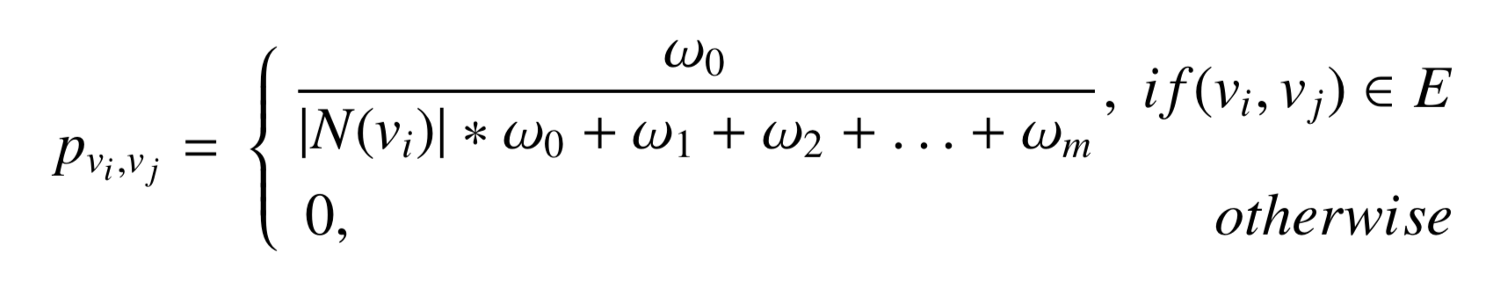
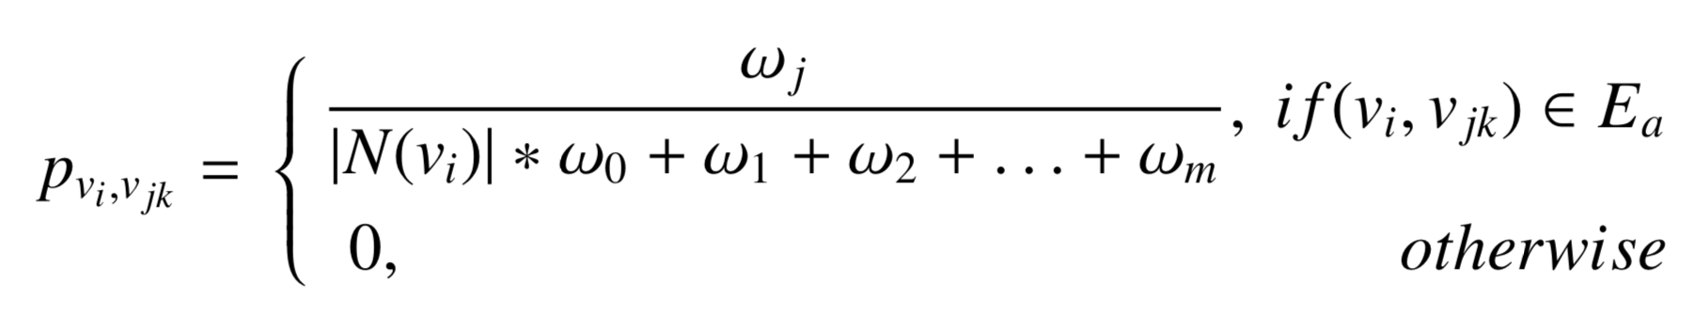
Calculation of transition Probability Matrix
Transition probability from vertex v_{i} to vertex v_{j} through a structure edge: (ω₀= weight of structure edge, ω_{i}= edge weight of attribute a_{i})
Transition probability from v_{i} to v_{jk} through an attribute edge:

Slide 18
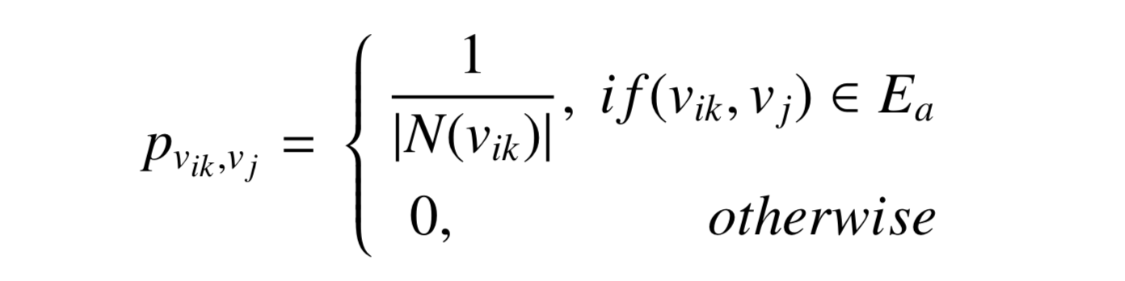
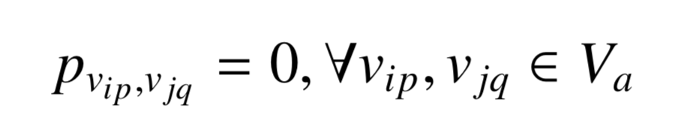
Calculation of transition Probability Matrix(contd)
Transition probability from v_{ik} to v_{j} through an attribute edge:
Transition probability between two attribute vertices v_{ip} and v_{jq} is 0 since there is no edge between two attribute vertices.

Slide 19
Clustering Algorithm
We assign a weight ω₀ to structure edges and ω_{i} to attribute edges on attribute a_{i}.
We initialise all weights to 1 and calculate the Transition Matrix.
Random walk distances are then calculated which is a measure of the similarity between vertices.
As different types of edges may have different degree of contributions, we need to learn the weights adaptively in the clustering process.

Slide 20
Clustering problem
This can be reduced to three subproblems:
1. Cluster assignment
Good initial centroids are essential for the success of partitioning clustering algorithms.
We assign each vertex to its closest centroid.
2. Centroid update
Update with the most centrally located vertex in each cluster.
3. Weight adjustment
The goal is to maximize the objective function.

Slide 21
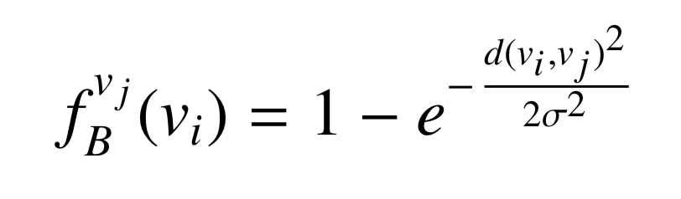
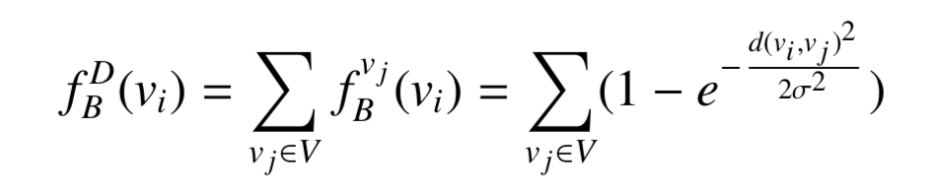
Cluster Centroid Initialization
Good initial centroids are essential for the success of partitioning clustering algorithms such as k-Means and k-Medoids.
k initial centroids are selected as follows:
The influence of one vertex v_{i} on another vertex v_{j} is defined as:
The density of a vertex v_{i} is the sum of the influence of v_{i} on all vertices in V:
The top k densest vertices are selected as the initial centroids {c₁⁰, c₂⁰,.., c_{k}⁰ }

Slide 22

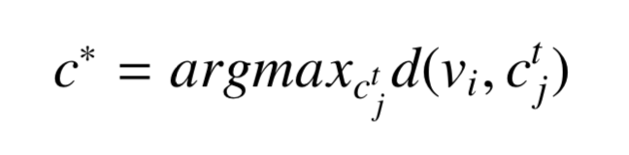
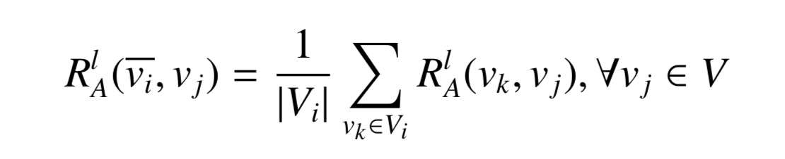
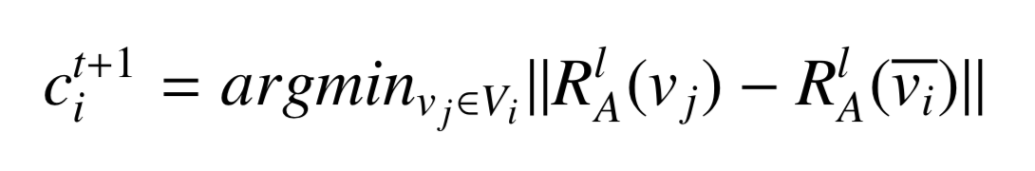
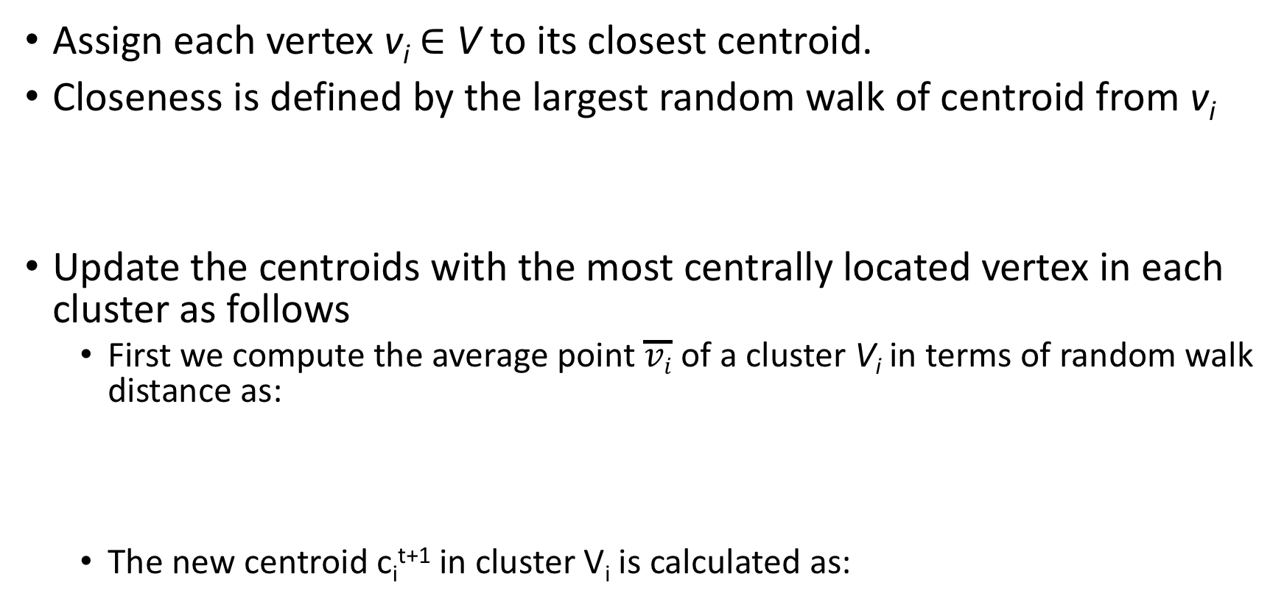
Clustering Process (K-mean)
Assign each vertex v_{i} ∈ V to its closest centroid.
Closeness is defined by the largest random walk of centroid from v_{i}
Update the centroids with the most centrally located vertex in each cluster as follows
First we compute the average point $\overline{vi}$ of a cluster V_{i} in terms of random walk distance as:
The new centroid c_{i}^{t+1} in cluster V_{i} is calculated as:

Slide 23
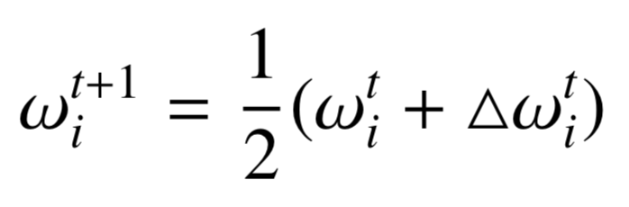
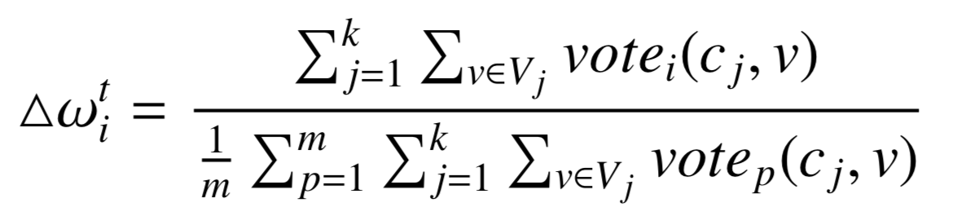
Weight Self-Adjustment
We fix ω₀ = 1.0 which is the structure edge weight and iteratively adjust the attribute weights {ω₁,...,ω_{m}} relative to ω_{0.}
In the t^{th} iteration the attribute weights are {ω^{t}₁, . . . , ω^{t}_{m}}
Weight increment △ω_{i} is determined by majority vote mechanism, the larger number of vertices which share attribute values, the larger △ω^{t}_{i}

Slide 24
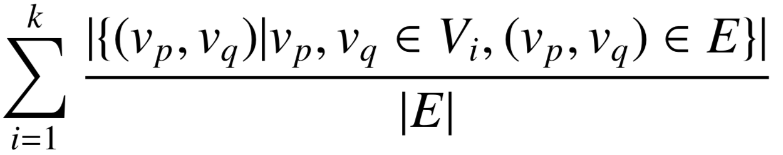
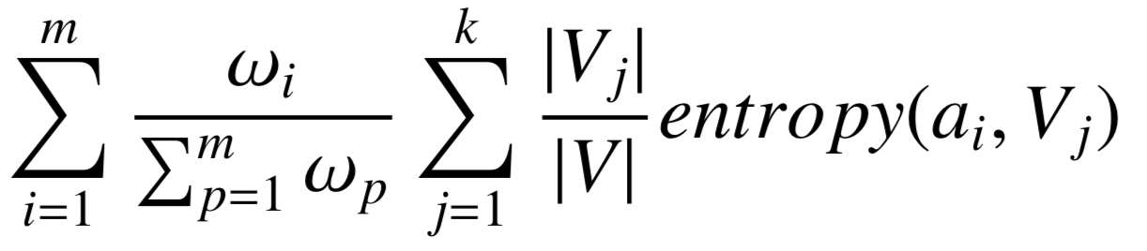
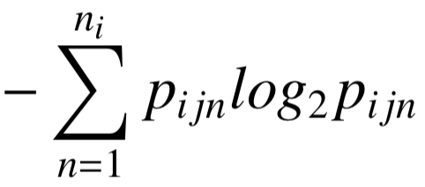
Experimental Evaluation
Political Blogs Dataset:
1490 vertices, 19090 edges, one attribute (political leaning)
Political Blogs Dataset
DBLP Dataset
5000 vertices, 16010 edges, two attributes prolific and topic
Evaluation Measures
Two measures of density and entropy are used to evaluate the quality of clusters {V_{i}}_{i=1}^{k}
density({V_{i}}_{i=1}^{k}) =
entropy({V_{i}}_{i=1}^{k}) =
entropy(a_{i} , V_{j}) =

Slide 25
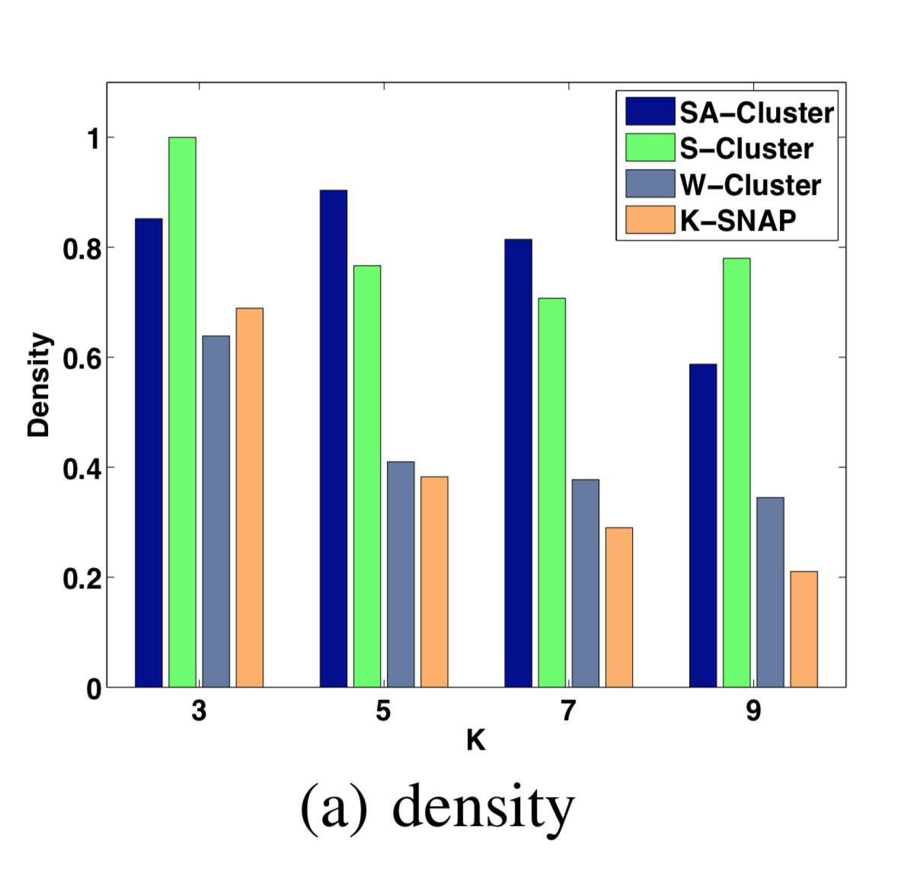
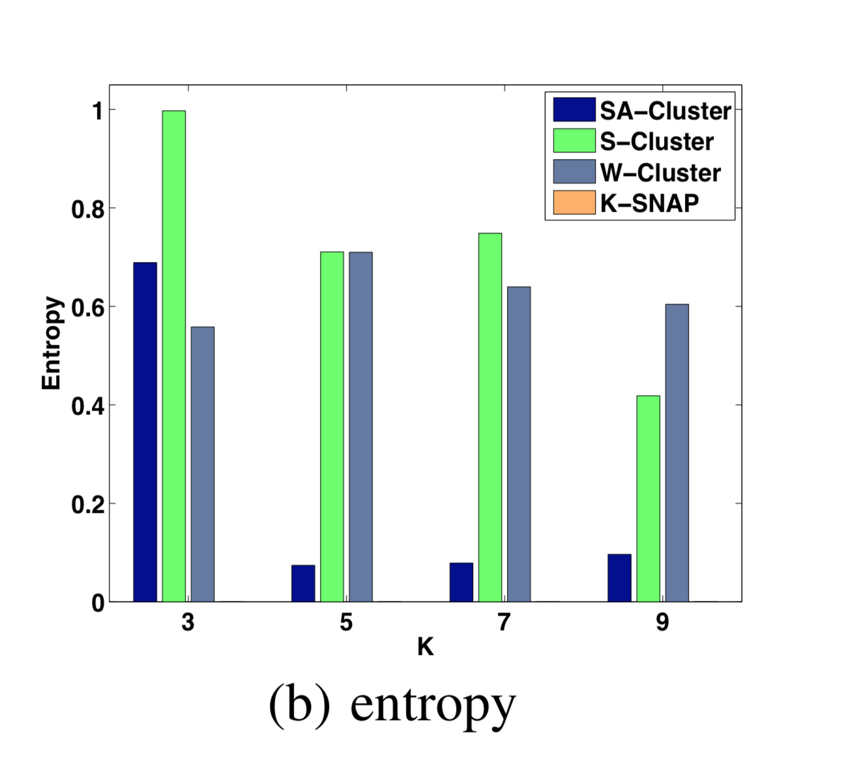
Cluster Quality Comparison on Political Blogs

Slide 26
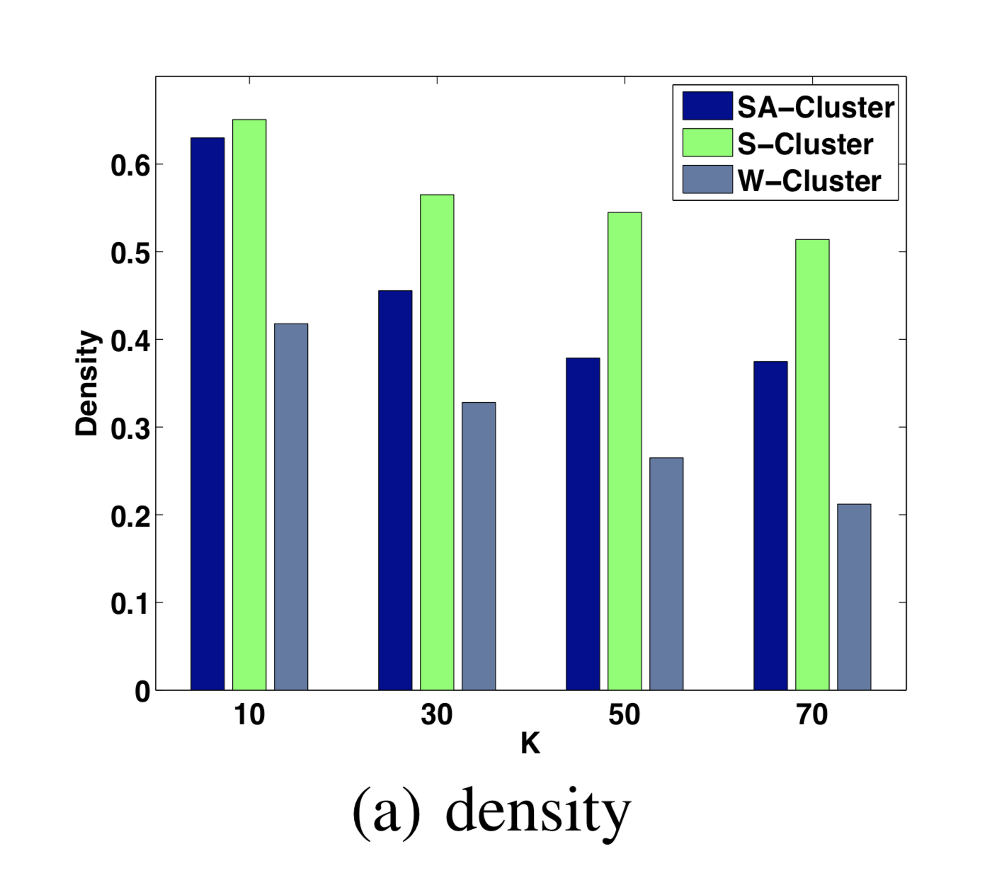
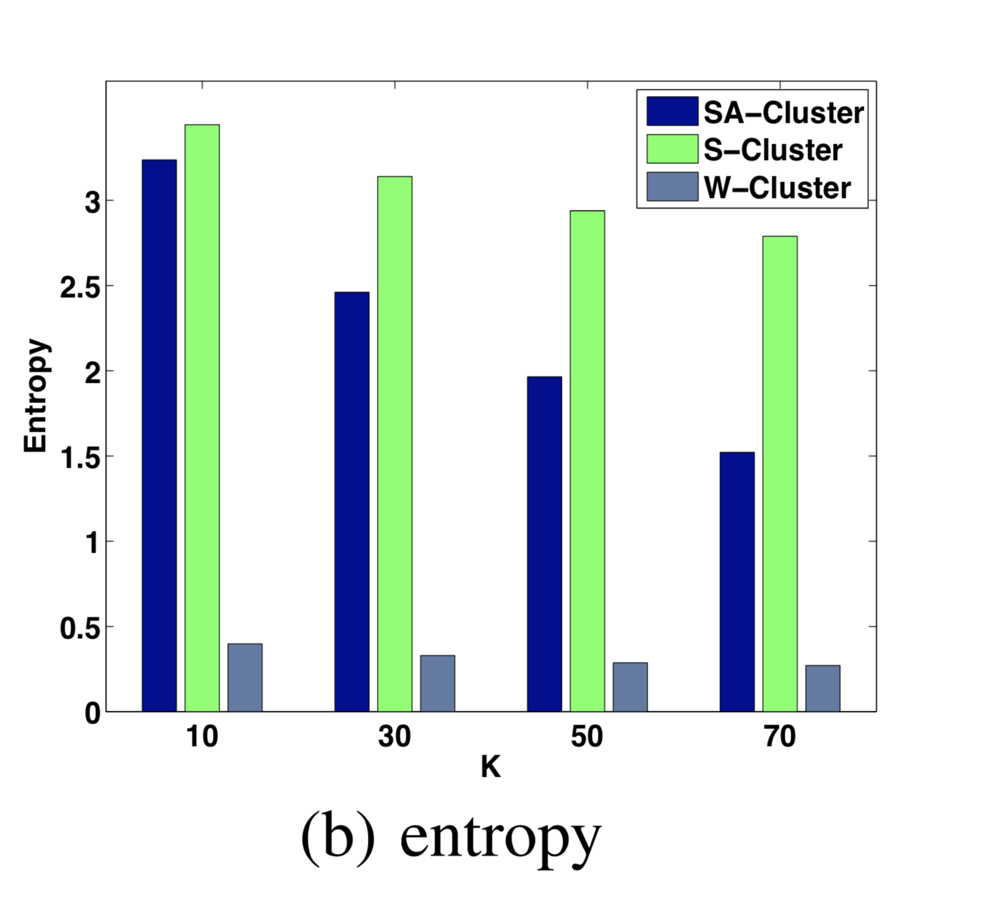
Cluster Quality Comparison on DBLP

Slide 27
Conclusions
Studied the problem of clustering graph with multiple attributes on the attribute augmented graph.
A unified neighbourhood random walk distance measures vertex closeness on an attribute augmented graph.
Automatically adjust the degree of contributions of different attributes towards the direction of clustering convergence.
Experimental results on two real graphs demonstrate that this method achieves a very good balance between structural and attribute similarities.

